Slide 1

The battle of neighborhoods
Toronto vs Manhattan

Slide 2
Comparison of Toronto and Manhattan Neighborhoods
Discover different neighborhoods
Explore similar and different venues
Visiting world renowned arts and galleries
Enjoying different international and experimental foods

Slide 3
Data Collection and Cleaning
New York City data will be obtained from a json file obtained from IBM Developer Skills Network
City of Toronto postal codes are obtained from a Wikipedia page
City of Toronto data will be obtained from a csv file that has the geographical coordinates of each postal code: http://cocl.us/Geospatial_dataFollowing
Number of restaurants and their type and location in every neighborhood will be obtained using Foursquare API

Slide 4
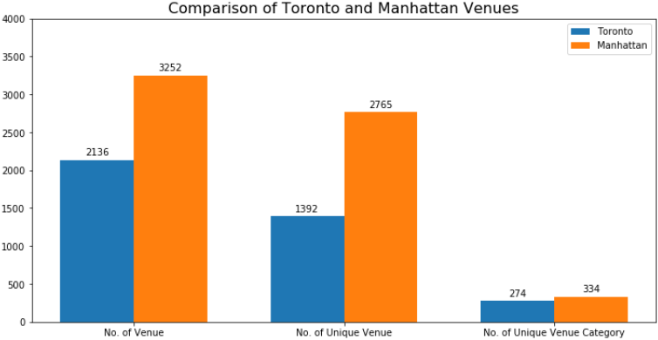

Slide 5
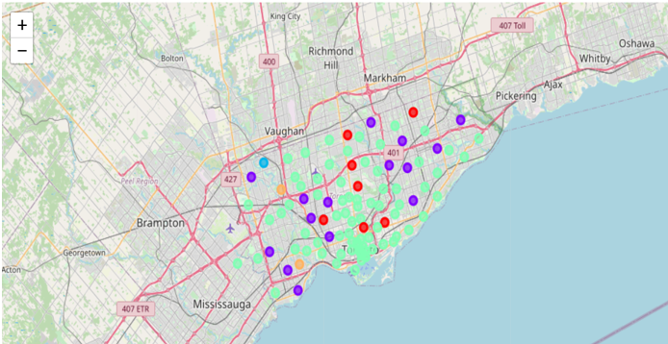
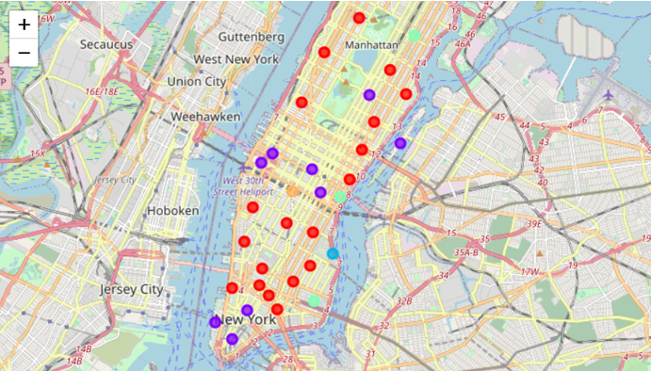
Clustering Neighborhoods by K-means clustering to cluster venue categories
Toronto’s cluster of neighborhoods:
Manhattan’s cluster of neighborhoods:

Slide 6
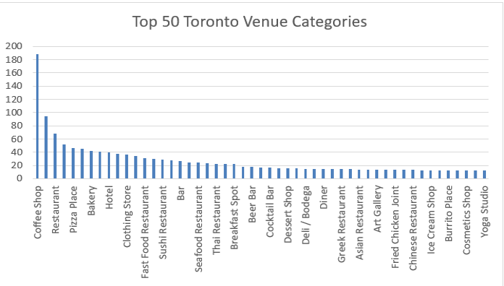
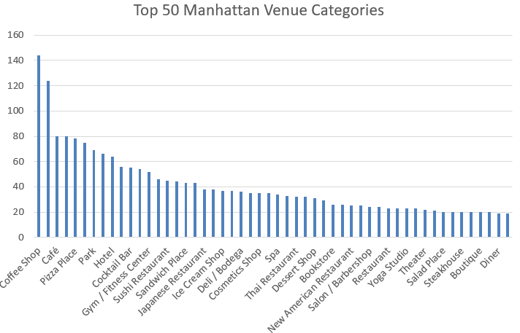
Comparison of Toronto and Manhattan Venue Categories
Top 50 Toronto Venue Categories
Top 50 Manhattan Venue Categories

Slide 7
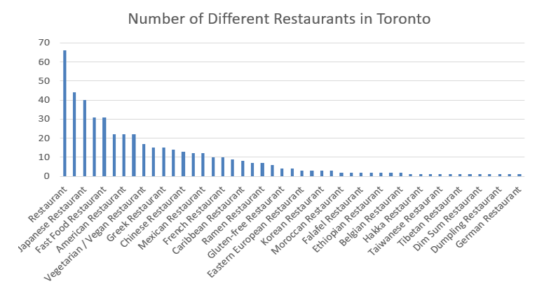
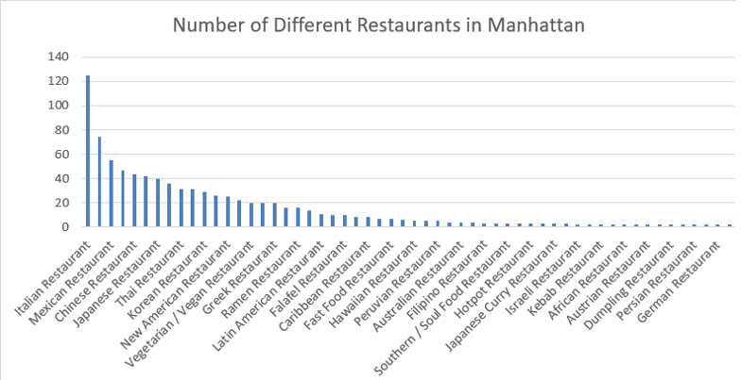
Comparison of Restaurants of Toronto and Manhattan
Toronto Restaurants
Manhattan Restaurants

Slide 8
Conclusion
Both Toronto and Manhattan have similar characteristics about the type of venues.
Manhattan has higher number of venues, unique venues, unique venue categories and restaurants than city of Toronto. Also, both cities offer some distinct venues and restaurants.
Toronto is more popular with Fast Food restaurants and Manhattan is more popular with Italian restaurants.
Three of the five clusters of both Toronto and Manhattan have Park, Coffee Shop and Restaurants

